Slide 1
QSPIDERS DECCAN PUNE
SQL PROJECT
Multi Speciality Hospital Data Management System
SUBMITTED TO:
MR. RAVI TEJA .M
Q SPIDERS, PUNE
SUBMITTED BY:
AAKANKASHA
AKSHATA MAHOORKAR
SHRUTIK VARKAD
SHIVAM PAWAR
PRAJYOT LABHSETWAR

Slide 2
CONTENTS
PROBLEM STATEMENT
GRAPH
TABLES CREATED
PATIENT TABLE
DOCTOR TABLE
TEST TABLE
BILL_TABLE
QUERIES
ADVANTAGES
FUTURE SCOPE
PROBLEM STATEMENT
CONCLUSION

Slide 3
PROBLEM STATEMENT
Fragmented Information Management : Multispecialty hospitals often struggle with managing vast amounts of patient data, medical records, and administrative information across different departments.
Resource Optimization : Efficient allocation of resources, including staff, equipment, and facilities, is essential for maximizing the hospital's capacity and ensuring smooth workflow.
Billing and Revenue Management : Billing and revenue management are critical aspects of hospital operations, but manual billing processes can be time-consuming, prone to errors, and difficult to track. Inaccurate billing can lead to financial losses and affect the hospital's revenue cycle.

Slide 4
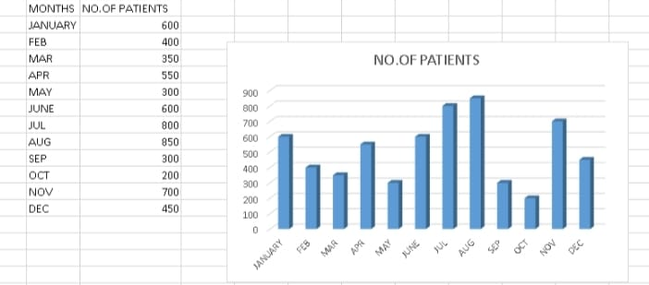
GRAPH
Fig1: Plot showing no. of Patients per months.

Slide 5
STEPS TAKEN TO SOLVE THE PROBLEM
Database Design : Choose an appropriate database management system (DBMS) based on the scalability, security, and performance requirements of the hospital.
Data Modeling: Define tables for each data entity identified during requirement analysis, along with their respective attributes. Establish relationships between tables using primary and foreign keys to maintain referential integrity.
Implementation : Create the database schema based on the finalized design using SQL or a graphical interface provided by the chosen DBMS.

Slide 6
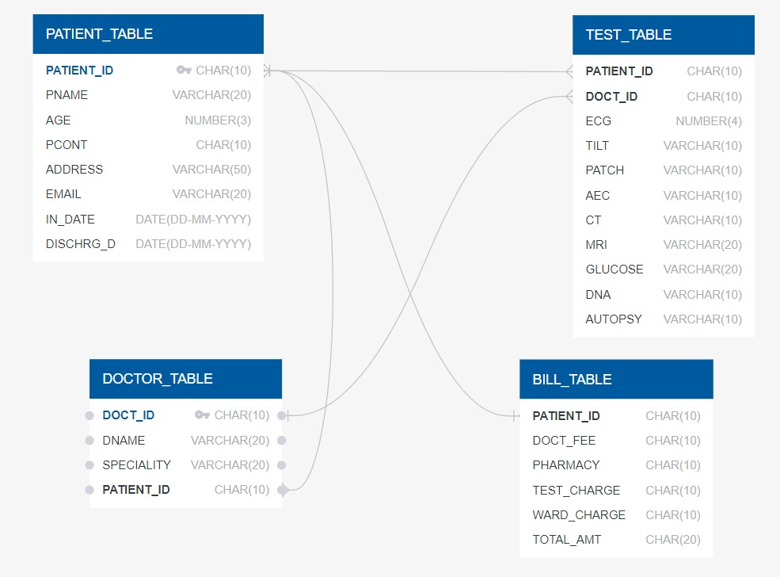
TABLES CREATED
PATIENT_TABLE | DOCTOR_TABLE | BILL_TABLE | TEST_TABLE
PATIENT_ID PNAME AGE PCONT ADDRESS EMAIL IN_DATE DISCHARG_D | DOCT_ID DNAME SPECIALITY PATIENT_ID | PATIENT_ID DOCT_FEE PHARMACY TEST_CHARGE WARD_CHARGE TOTAL_AMT | PATIENT_ID DOCT_ID ECG TILT PATCH AEC CT MRI GLUCOSE DNA AUTOPSY

Slide 7
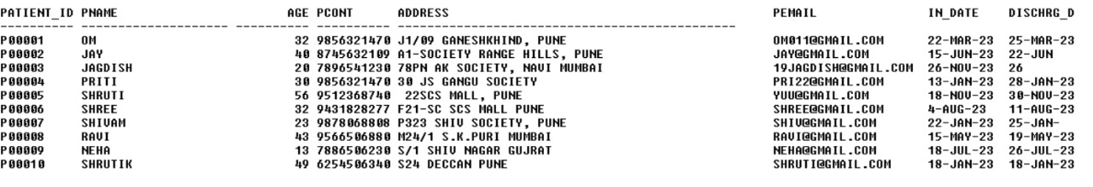
1. PATIENT TABLE
Patient table is a Parent Table.
It consists of PATIENT_ID,PNAME,AGE,PCONT,ADDRESS,EMAIL,IN_DATE,DISCHARG_D

Slide 8
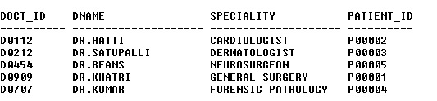
2. DOCTOR TABLE
Doctor table is a child table.
It consists of DOC_ID, DNAME, SPECIALLIST, PATIENT_ID.

Slide 9
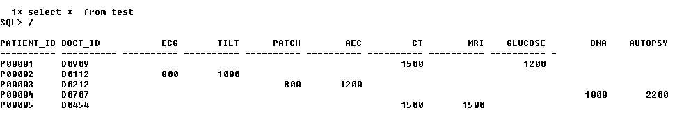
3. TEST TABLE
Test table is a Child Table.
It consists of PATIENT_ID,DOCT_ID,ECG,TILT,PATCH,AEC,CT,MRI,GLUCOSE,DNA,AUTOPSY

Slide 10
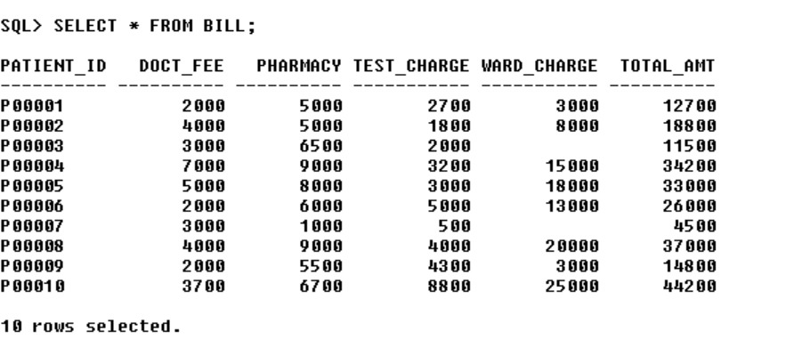
4. BILL TABLE
Bill_Table table is a Child Table.
It consists of PATIENT_ID,DOCT_ID,ECG,TILT,PATCH,AEC,CT,MRI,GLUCOSE,DNA,AUTOPSY

Slide 11
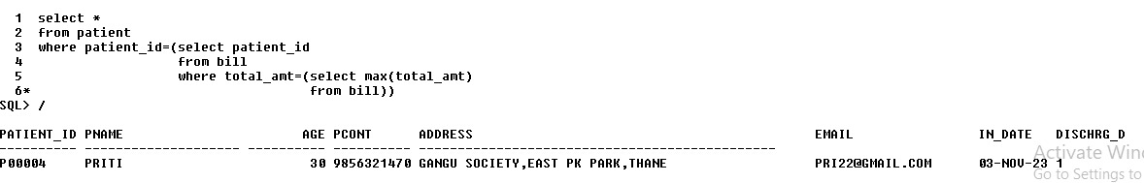
QUERIES
Give me the details of patient who have paid the highest amt in our hospital.

Slide 12
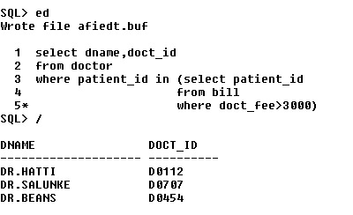
Show me the doctor's name and his/her id who charge more than 3000 to the patient.

Slide 13

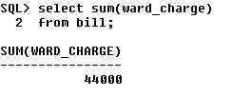
Show me the doctor who is free / no assigned patient.
Revenue collected by charging ward for the patient.

Slide 14
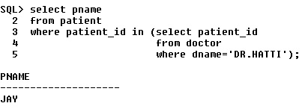
Show me the names of patients who have been treated by Dr.HATTI .

Slide 15
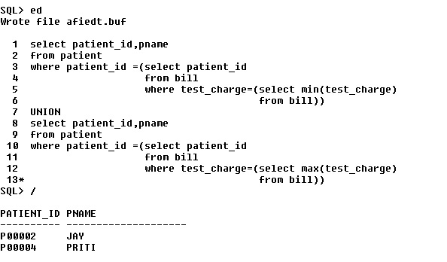
Give me the patient name and their id who had paid minimum and maximum test charge togetherly.

Slide 16
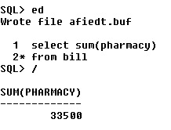
Revenue collect by pharmacy department.

Slide 17
ADVANTAGES
Centralized Information Management
Improved Patient Care
Enhanced Communication and Collaboration
Data-driven Decision Making
Better Financial Management

Slide 18
Future scope
Integration with Emerging Technologies: Integration with AI, ML, and IoT for enhanced diagnostics, personalized treatment, and automation.
Telemedicine and Remote Monitoring: Support for virtual consultations and remote patient monitoring to extend care beyond hospital walls.
Advanced Analytics: Utilization of data analytics for predictive modeling, trend analysis, and operational optimization.
Interoperability and HIE: Seamless exchange of health information with external systems for coordinated care and decision-making.
Patient Engagement: Empowerment through patient portals, mobile apps, and wearable devices for active participation in care.

Slide 19
conclusion
The Multispecialty Hospital Management System (MHMS) database project streamlines hospital operations, enhances patient care coordination, and improves operational efficiency. By centralizing patient information, automating processes, and ensuring compliance, the MHMS database facilitates better healthcare delivery and resource management, ultimately leading to improved patient outcomes and cost savings for healthcare organizations.

